Slide 1


BE Project Final Review (Sem VIII)
Vivekanand Education Society’s Institute of Technology
Electronics and Telecommunication Engineering
Name of Guide : Mrs. Neeta Chavan
PCOS Detection Using Machine Learning
Group No. : A9
1 Aishvarya Birambole- 05(D19A)
2 Isha Chavan- 06(D19A)
3 Saakshi Karkera- 20(D19A)
4 Risa Samanta- 34(D19B)

Slide 2
Contents to be covered
Problem Statement
Proposed Solution
Literature Survey
Research Gaps
Complete Block Diagram of Proposed System
Methodology
Components requirement
Software Implementation
Publication oriented/Patent oriented/National level Project Competition Oriented
References

Slide 3
Problem Statement
Polycystic Ovary Syndrome (PCOS) is a condition that affects a woman's hormone levels.
Unmanaged PCOS can impact short and long term health. It’s associated with type 2 diabetes, infertility, cardiovascular disease, obesity, sleep apnea (disrupted breathing in sleep), non-alcoholic fatty liver disease and depression.
Most of the time women are unable to recognize whether they have PCOS or not at it’s early stage and therefore it may get worse day by day.
To eradicate this serious problem we built this project with motivation to provide a platform for women who feel shy about going to a doctor to check if they have pcos or not.

Slide 4
Proposed Solution
So we have built a platform which takes input from the user and then processes it with the help of Machine Learning algorithm and generates the result as whether the person has pcos or not.
In our proposed solution the first step is early detection.
The patients would be asked a set of 28 questions suggested by a medical professional. Based on their answers we will detect the result and if PCOS is detected then further the patient would be asked to perform two tests viz. blood test, pelvic ultrasound test.
The parameters of reports are provided as input again to the Machine Learning Model. It will predict whether the patient is diagnosed with PCOS or not.

Slide 5
Literature Survey
Sr. No. | Title of Technical paper | Name of Author | Year of publication | Name of Journal | Methodology | Results/ conclusions | Limitations
1 | Detection And Prediction System For Polycystic Ovary Syndrome Using Machine Learning Techniques | Amsy Denny, Anita Raj | 2019 | IEEE Region 10 Conference (TENCON 2019) | Involves the formulation of a feature vector based on real time data from patients during clinical and radiological investigation while they visit a healthcare facility. | Among various algorithms used, RF algo is found superior in performance. This automated system can act as an assistive tool for doctor for saving considerable time in examining the patients and hence reducing the delay in diagnosing the risk of PCOS. | Various clinical test data like quantity of FSH, LH, Neutrophils, etc are required for initializing the proposed system.

Slide 6
Literature Survey(continued….)
Sr. No. | Title of Technical paper | Name of Author | Year of publication | Name of Journal | Methodology | Results/ conclusions | Limitations
2 | PCOcare: PCOS Detection and Prediction using Machine Learning Algorithms | Vaidehi Thakre, Shreyas Vedpathak | 2020 | Bioscience Biotechnology Research Communications | Multiple machine learning models like RF classifier, SVM, gaussian naive bayes are used to check which model gives the most accurate results. Users has to provide the inputs on pcoscare webapp then feature analysis will be done on given parameters. | The proposed system can be used by both patients and doctors too, as a doctor can filter new patients with basic info and give priority to treat patients with PCOS first and then meet patients who do not have PCOS. | Since user has to put required abstruse parameters as input the proposed platform is not user-friendly.

Slide 7
Literature Survey(continued….)
Sr. No. | Title of Technical paper | Name of Author | Year of publication | Name of Journal | Methodology | Results/ conclusions | Limitations
3 | Diagnosis of Polycystic Ovary Syndrome Using Machine Learning Algorithms | Subrato Bharati, Prajoy Podder, M. Rubaiyat Hossain Mondal | 2020 | IEEE Region 10 Symposium (TENSYMP) | A univariate feature selection algorithm is applied to find the best features that can predict PCOS. The ranking of the attributes is computed and it is found that the most important attribute is the ratio of Follicle-stimulating hormone (FSH) and Luteinizing hormone (LH). Next, holdout and cross validation methods are applied to the dataset to separate the training and testing data. Gradient boosting, random forest, logistic regression, and hybrid random forest and logistic regression (RFLR) classifiers are applied to the dataset. | The first 10 highest ranked attributes are good enough to predict PCOS disease. It also demonstrate that RFLR exhibits the best testing accuracy of 91.01% and recall value of 90% using 40-fold cross validation applied to the 10 most important features. Hence, RFLR is suitable for reliably classifying PCOS patients. | The machine learning algorithms are applied to a dataset freely available in Kaggle repository and the best 10 features are obtained through it.

Slide 8
Literature Survey(continued….)
Sr. No. | Title of Technical paper | Name of Author | Year of publication | Name of Journal | Methodology | Results/ conclusions | Limitations
4 | Detecting PCOS using Machine Learning | Namrata Tanwani | 2020 | International Journal of Modern Trends in Engineering and Science | There were total of 39 parameters out of which only 9 parameters,with the highest weights were considered for KNN and 10 parameters, were considered for Logistic Regression. A comparison was made between the two different classifiers: linear and nonlinear. The linear classifier is KNN while the nonlinear classifier is the model of Logistic Regression. The F1 score helps determine the best model between the two. The F1 score for KNN is 0.90 and for that of Logistic Regression is 0.92, hence, model of Logistic Regression is selected to determine the absence or presence of PCOS. | The best accurate model built is Logistic Regression with accuracy 92%. | Only comparison between K-nearest Neighbour and Logistic regression is done for detecting PCOS

Slide 9
Literature Survey(continued….)
Sr. No. | Title of Technical paper | Name of Author | Year of publication | Name of Journal | Methodology | Results/ conclusions | Limitations
5 | Automated Detection of Polycystic Ovary Syndrome Using Machine Learning Techniques | Yasmine A. Abu Adla, Dalia G. Raydan | 2021 | Institute of Electrical and Electronics Engineers(IEEE) | Dataset that consisted of 39 features ranging from metabolic, imaging, to hormonal and biochemical parameters for 541 subjects was used. They applied pre-processing on the data. After, a hybrid feature selection approach was implemented to reduce the number of features using filters and wrappers. Different classification algorithms were then trained and evaluated. Based on a thorough analysis, the Support Vector Machine with a Linear kernel (Linear SVM) was chosen, as it performed best among the others in terms of precision (93.665%) as well as high accuracy (91.6%) and recall (80.6%). | Sequential Forward Floating Selection (SFFS) is used to enhance the performance of our model to select the best features. The best algorithm was found to be Linear Support Vector Machine with 24 features. Both precision and accuracy of this algorithm were above 90%, whereas its recall was around 80%. | Only analysis is done. Web Interface is not provided

Slide 10
Literature Survey(continued….)
Sr. No. | Title of Technical paper | Name of Author | Year of publication | Name of Journal | Methodology | Results/ conclusions | Limitations
6 | PCOS Detect using Machine Learning Algorithms | Kinjal Raut , Chaitrali Katkar , Prof. Dr. Mrs. Suhasini A. Itkar | 2022 | International Research Journal of Engineering and Technology (IRJET) | The experimentation is performed on the dataset using various machine learning algorithms. The main objective is to find most suitable algorithm for the classification of the dataset created. The algorithms used to construct the model are Decision Tree, SVM, Random Forest, Logistic Regression, K Nearest Neighbor and CatBoost Classifier. | Among the various algorithms used CatBoost Classifier was found superior in performance | Only comparison of various algorithms is done to check which algorithm performs better

Slide 11
Research Gaps
Do I Have PCOS?
https://www.endocrineweb.com/guides/pcos/do-have-pcos-pcos-symptoms-quiz
Here Only Prediction is done
2. Jeanhailes
https://www.jeanhailes.org.au/health-a-z/pcos
This is only pcos awareness webpage.

Slide 12
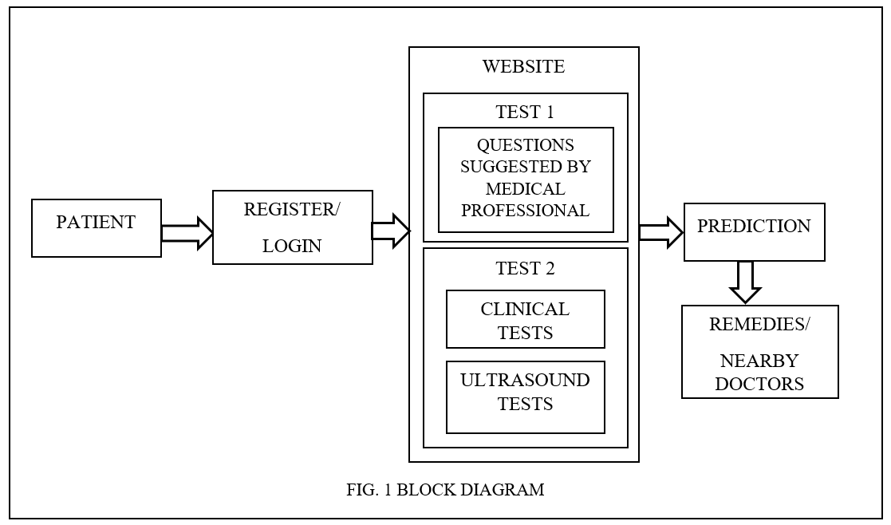
Complete Block Diagram of Proposed System:

Slide 13
Methodology
For early detection we have asked 28 questions suggested by a medical professional. These answers will be given to Stacked model
Before taking stacked model classifier model in consideration we have compared 5 different ML models like Logistic Regression, Support Vector Machine, K-Nearest Neighbour, Random Forest, Gradient Boost Decision Tree are tested their accuracy by use of confusion matrix.
If our model predicts early detection then we’ll go for further 2 tests in which users have to do blood tests to check hormone levels and glucose levels, a pelvic ultrasound to look for cysts in ovaries.
These inputs are given to the Machine Learning Model which will predict whether the patient is diagnosed with PCOS or not.

Slide 14
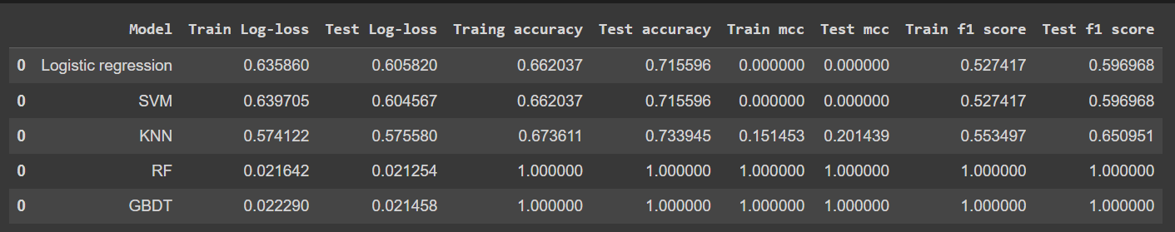
Comparison of Machine Learning Algorithms
Table.1 Comparison of Machine Learning Algorithms

Slide 15
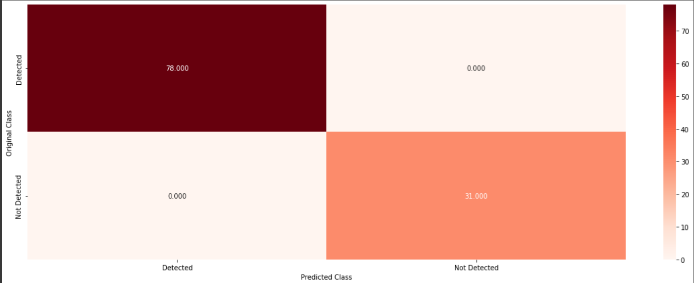
Comparison of Machine Learning Algorithms
Fig.2 Comparison of Machine Learning Algorithms

Slide 16
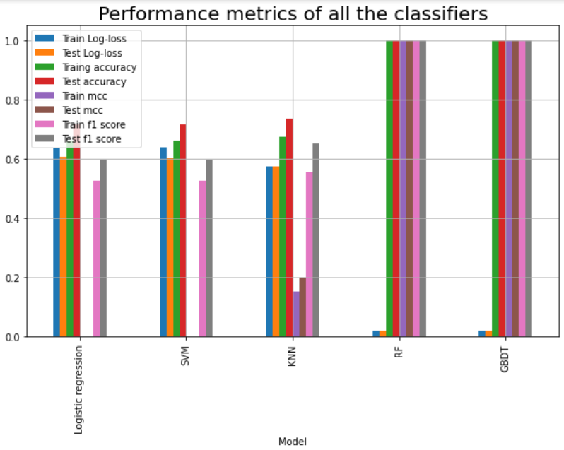
Performance Metrics of all the Classifiers
Fig.3 Performance Metrics Of all the classifiers

Slide 17
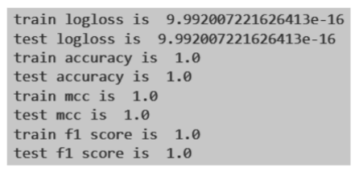
Fig 4. Results after Stacking KNN, RF and GBDT

Slide 18
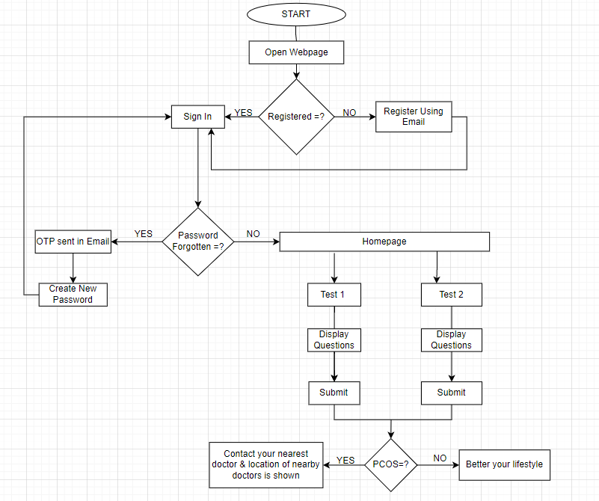
Software Flowchart:
Fig.5 Flowchart

Slide 19
Components requirement
Software-
Visual Studio Code - Open Source
Xampp Server - Open Source

Slide 20
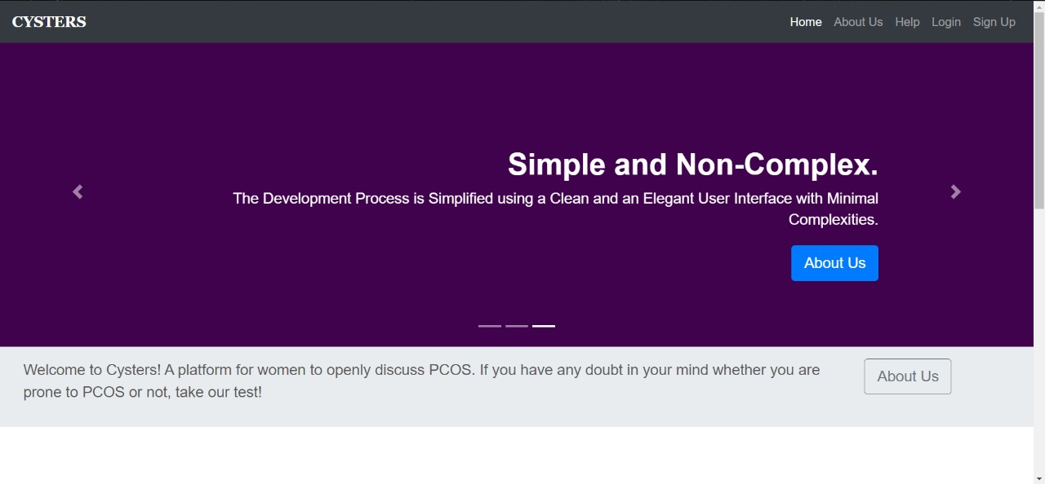
Software Implementation

Slide 21
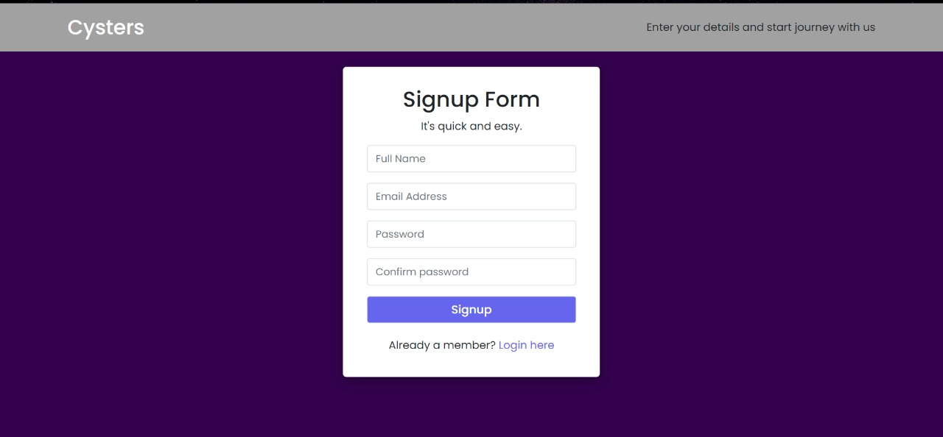
Software Implementation

Slide 22

Software Implementation

Slide 23

Software Implementation

Slide 24

Software Implementation

Slide 25

Software Implementation

Slide 26

Software Implementation

Slide 27

Software Implementation

Slide 28

Software Implementation

Slide 29
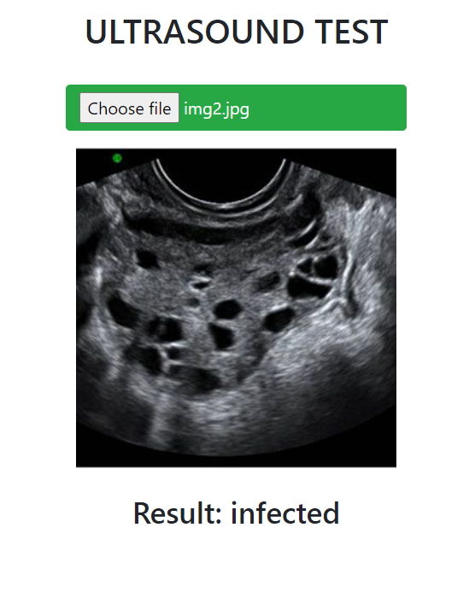
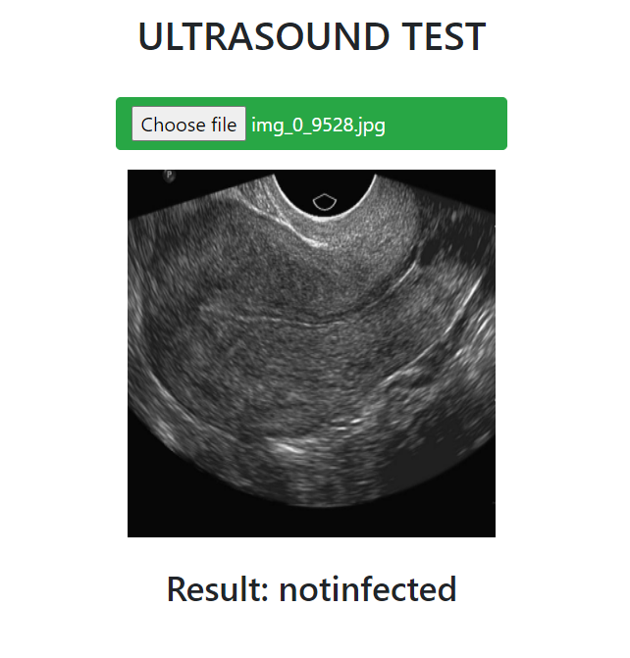
Software Implementation

Slide 30
Publication oriented/Patent oriented/National level Project Competition Oriented
We have attended and presented our paper at ICACCS 2023 (2023 9th International Conference on Advanced Computing and Communication Systems )

Slide 31
Conclusion
We have compared well known machine learning techniques, such as K-Nearest Neighbors, Linear Support Vector Machine, Random Forest Classifier, Logistic Regression and Gradient Boost Decision Tree.
The accuracy of the Random Forest algorithm in diagnosing PCOS was 100% according to the performance validation criteria (MCC, accuracy, train log loss, test log loss, and F1 score)
Login Page is created using html and is secured by Email OTP Verification.
On successful login user can take the test and check whether she is prone to PCOS or not.
Also CNN is used for the Ultrasound test and detection of infected and not infected ovary is done.
The final test results are predicated by use of stacking of KNN, RF and GBDT machine learning algorithms with 100% accuracy.

Slide 32
References
[1] Amsy Denny, Anita Raj, Ashi Ashok, Maneesh Ram C, Remya George, “Detection And Prediction System For Polycystic Ovary Syndrome Using Machine Learning Techniques”, IEEE Region 10 Conference (TENCON 2019), vol. 67, no. 11, pp. 654–658, 2019.
[2] Vaidehi Thakre, Shreyas Vedpathak , Kalpana Thakre and Shilpa Sonawani, “PCOcare: PCOS Detection and Prediction using Machine Learning Algorithms”, Bioscience Biotechnology Research Communications”, vol. 13, no. 14, pp. 240-244, 2020.
[3] Subrato Bharati, Prajoy Podder, M. Rubaiyat Hossain Mondal, “Diagnosis of Polycystic Ovary Syndrome Using Machine Learning Algorithms”, IEEE Region 10 Symposium (TENSYMP), vol.12, no.13, pp. 1486-1489, 2020.
[4] Namrata Tanwani, “Detecting PCOS using Machine Learning”, IJMTES | International Journal of Modern Trends in Engineering and Science ISSN: 2348-3121, Volume:07 Issue:01 2020.
[5] Yasmine A. Abu Adla, Dalia G. Raydan and Mohammad-Zafer J. Charaf, “Automated Detection of Polycystic Ovary Syndrome Using Machine Learning Techniques”, IEEE, vol. 2, no. 22, pp. 128-138, 2021.
[6] Kinjal Raut , Chaitrali Katkar , Prof. Dr. Mrs. Suhasini A. Itkar, “PCOS Detect using Machine Learning Algorithms ”, International Research Journal of Engineering and Technology (IRJET), pp. 1214-1218, 2022.

